Slide 1



Denoising Diffusion Probabilistic Models
Jonathan Ho, Ajay Jain, Pieter Abbeel
UC Berkeley
발표자: 최창용
2022.12.16

Slide 2
Content
Introduction
Background
Diffusion models and denoising autoencoders
Experiments
Conclusion

Slide 3
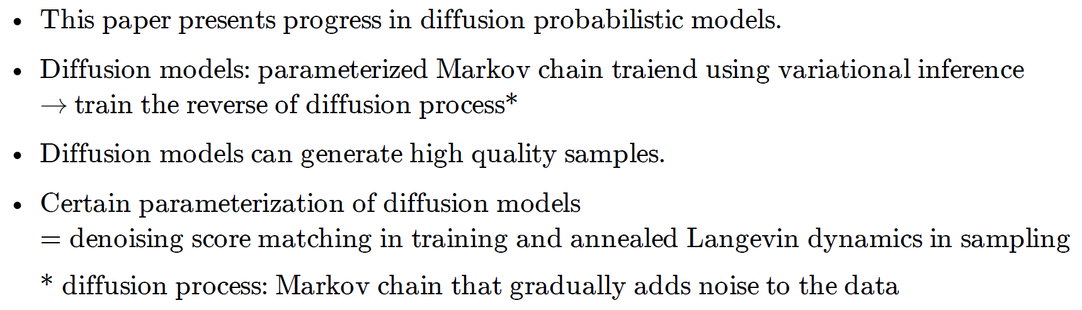
1. Introduction

Slide 4
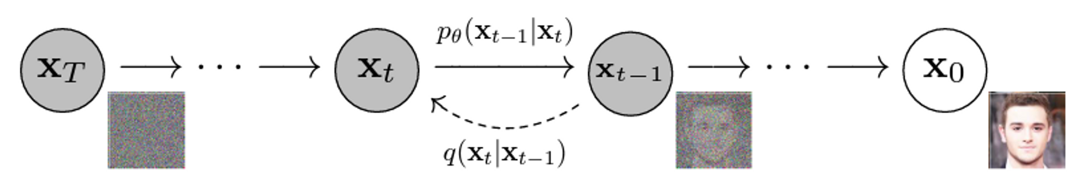

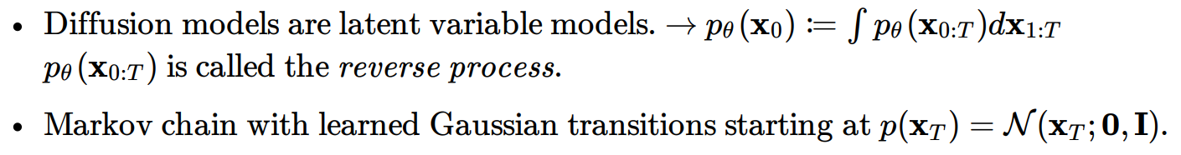
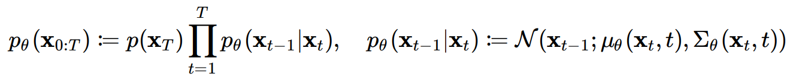

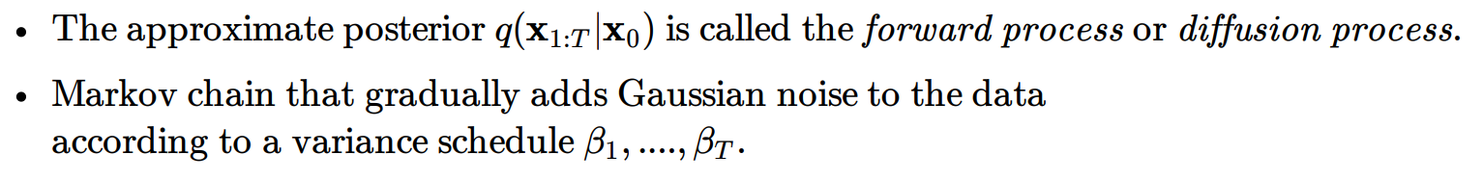
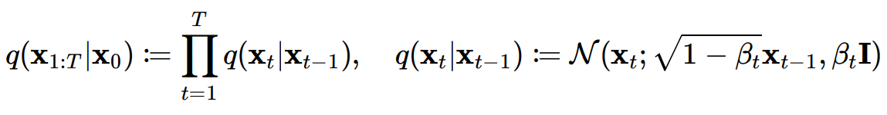
2. Background

Slide 5
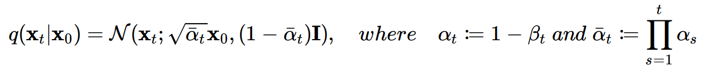
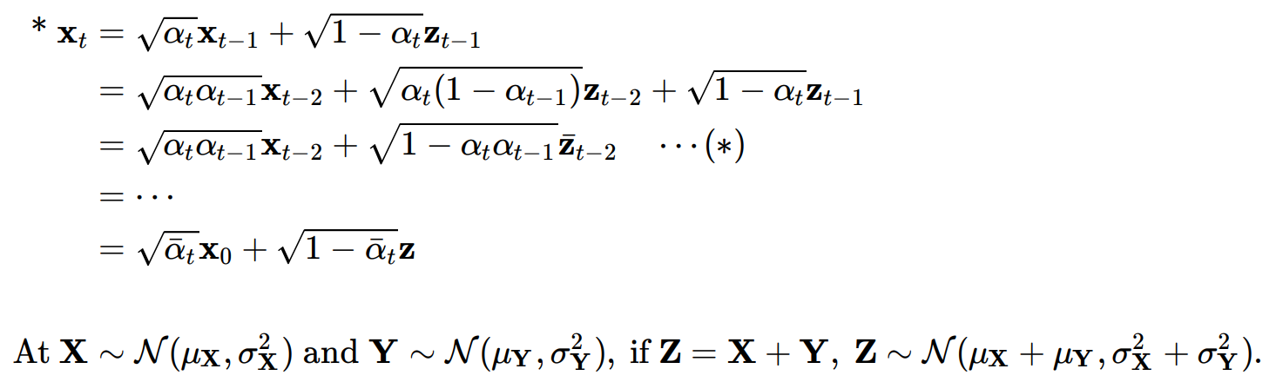
2. Background

Slide 6
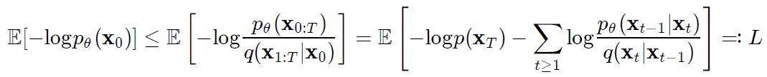
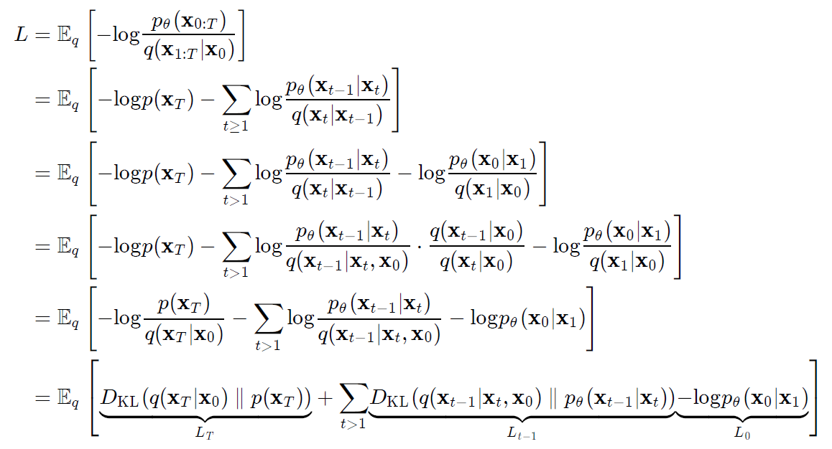
2. Background

Slide 7
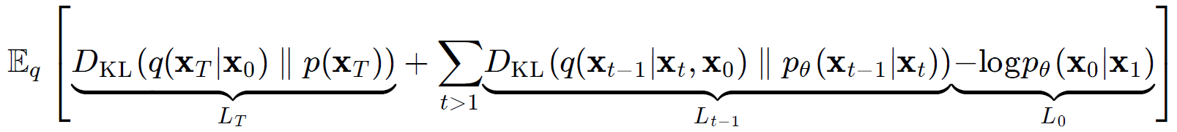
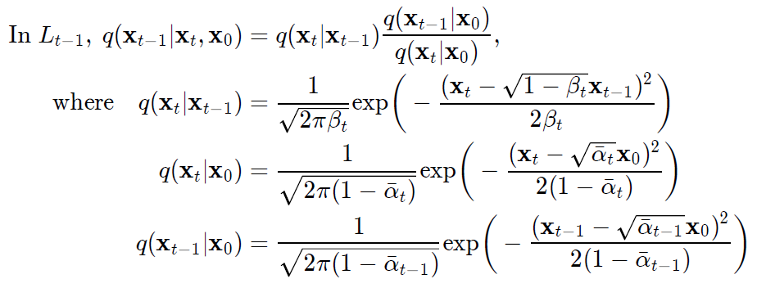
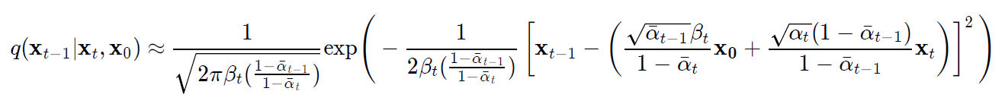
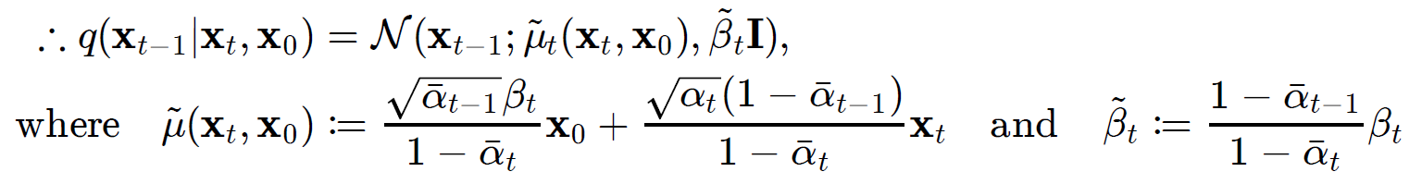
2. Background

Slide 8
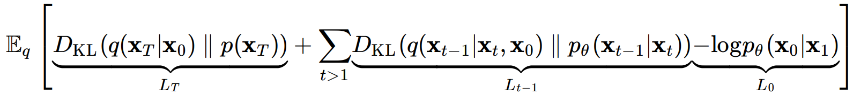
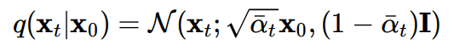
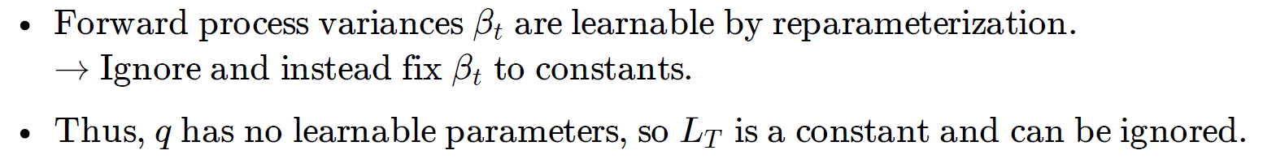
3. Diffusion models and denoising autoencoders
3.1 Forward process and L_{T}

Slide 9
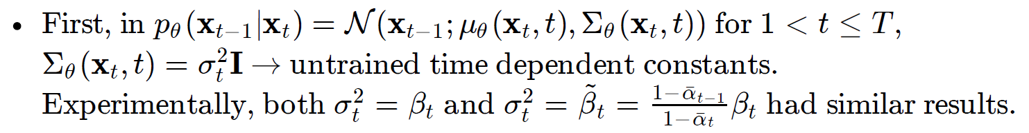
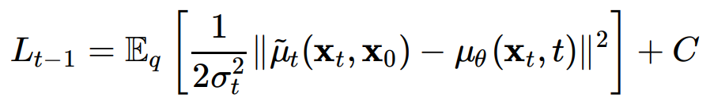
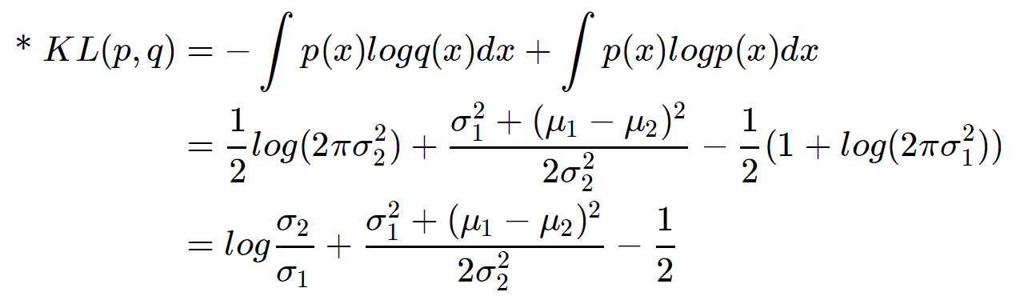
3. Diffusion models and denoising autoencoders
3.2 Forward process and L_{T}

Slide 10
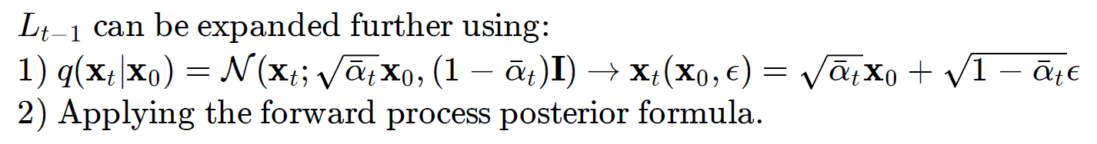
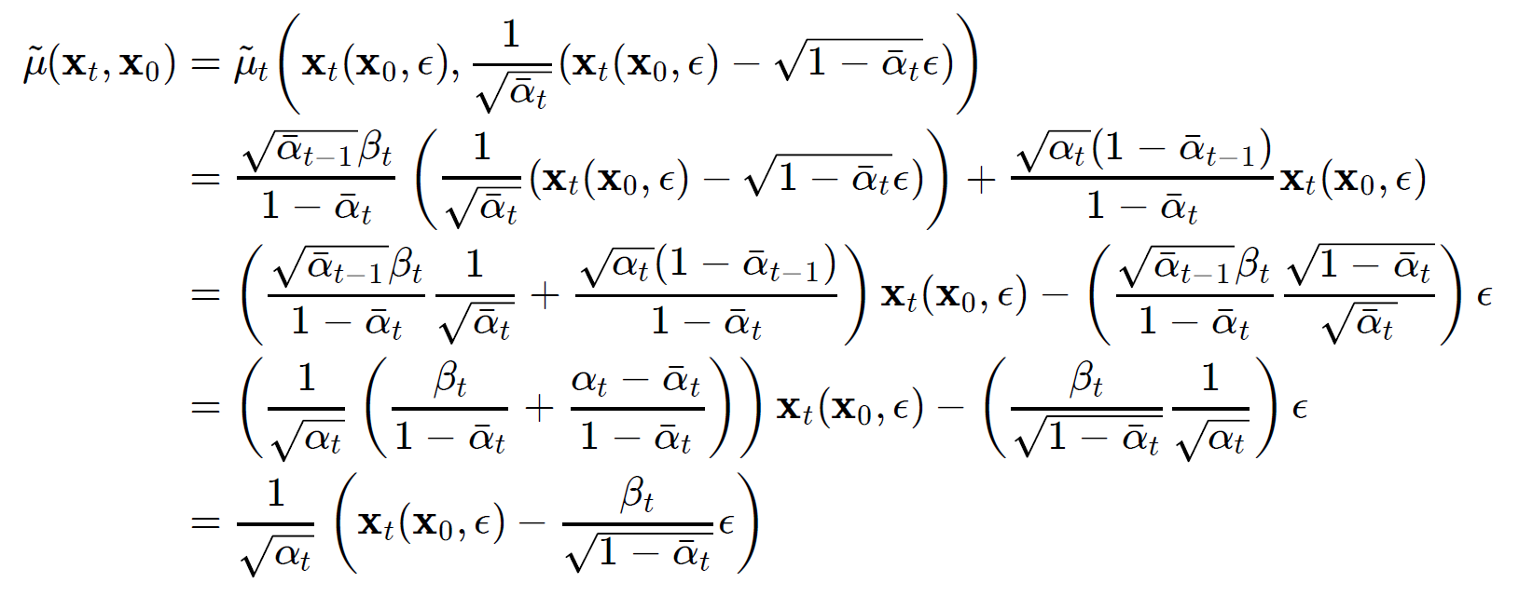
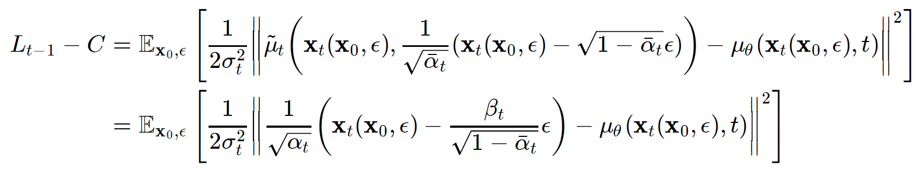
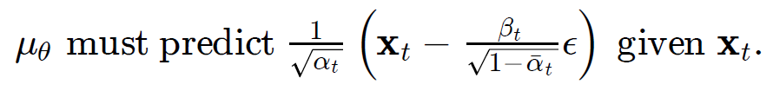
3. Diffusion models and denoising autoencoders
3.2 Forward process and L_{T}

Slide 11
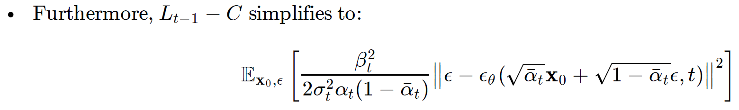
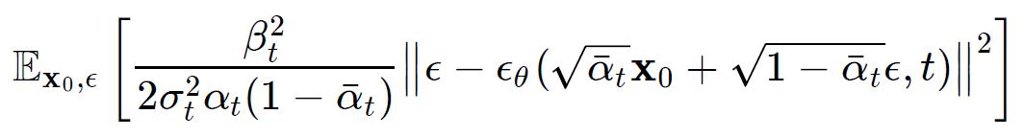
3. Diffusion models and denoising autoencoders
3.2 Forward process and L_{T}

Slide 12
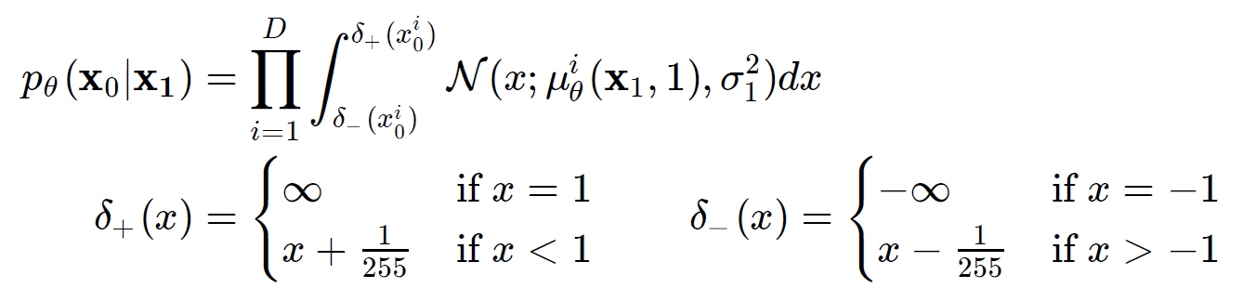
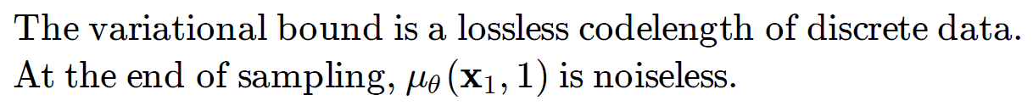
3. Diffusion models and denoising autoencoders
3.3 Data scaling, reverse process decoder, and L₀

Slide 13
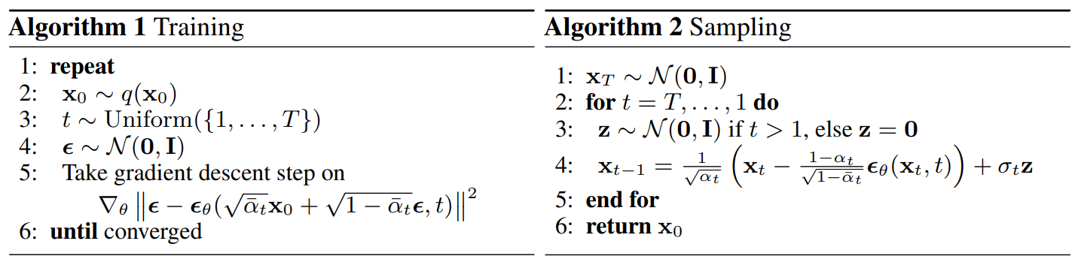
3. Diffusion models and denoising autoencoders
3.4 Simplified training objective

Slide 14
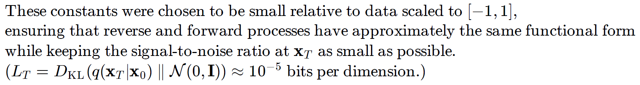
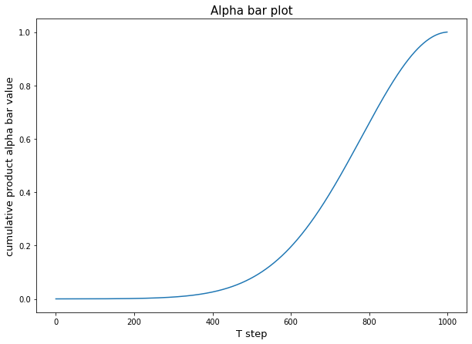
4. Experiments

Slide 15
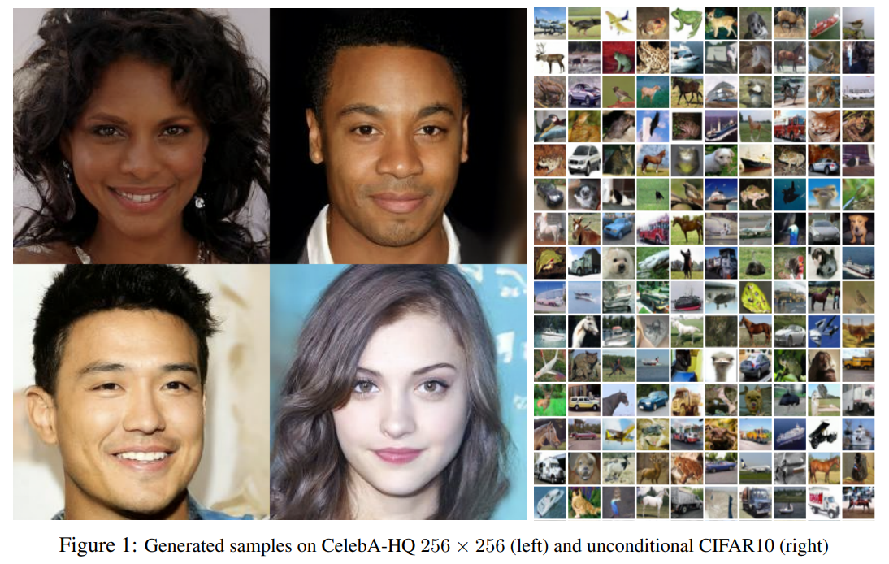
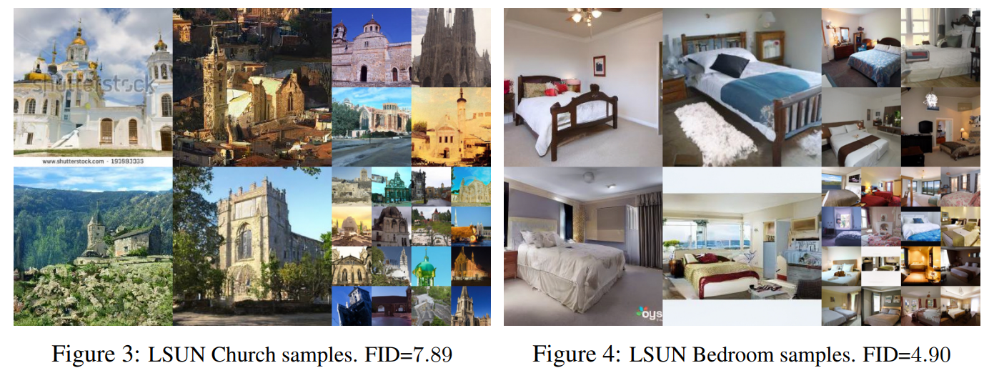
4. Experiments
4.1 Sample quality

Slide 16
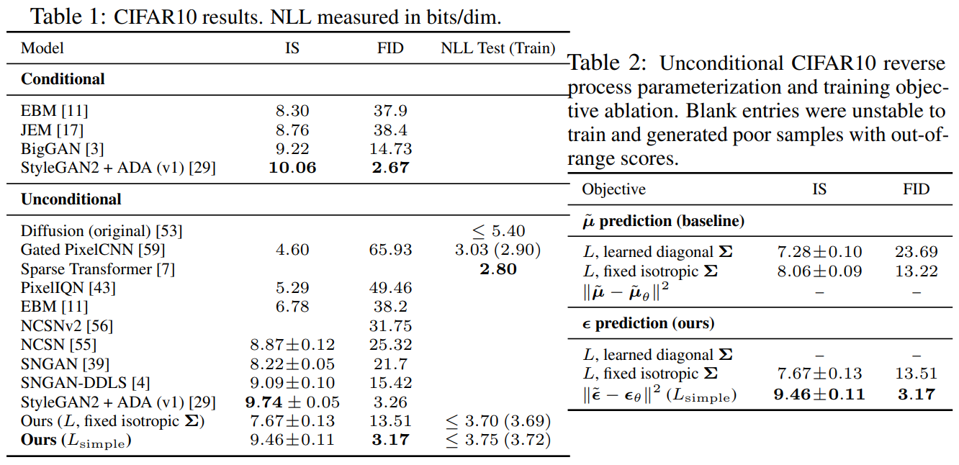
4. Experiments
4.1 Sample quality, 4.2 Reverse process parameterization and training objective ablation

Slide 17
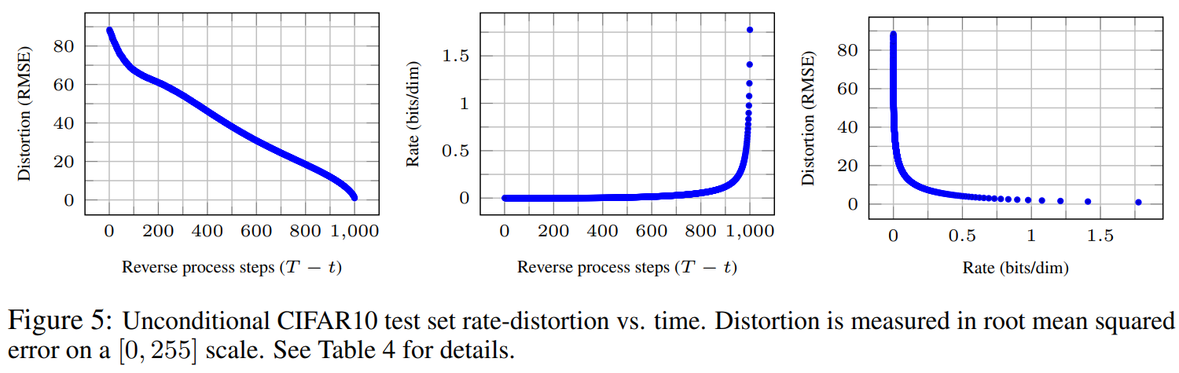
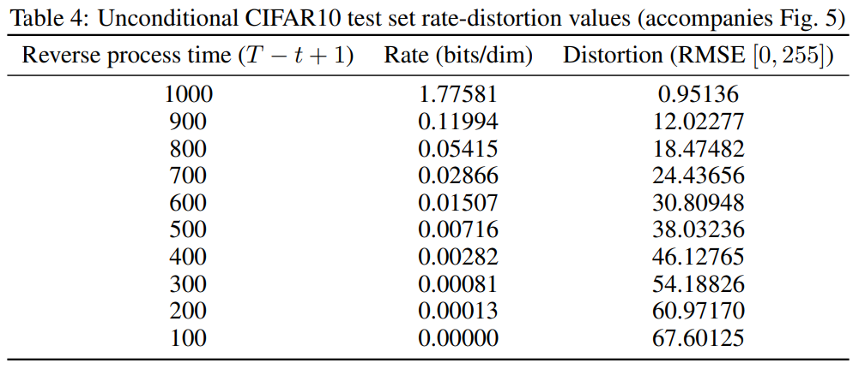
4. Experiments
4.3 Progressive coding

Slide 18
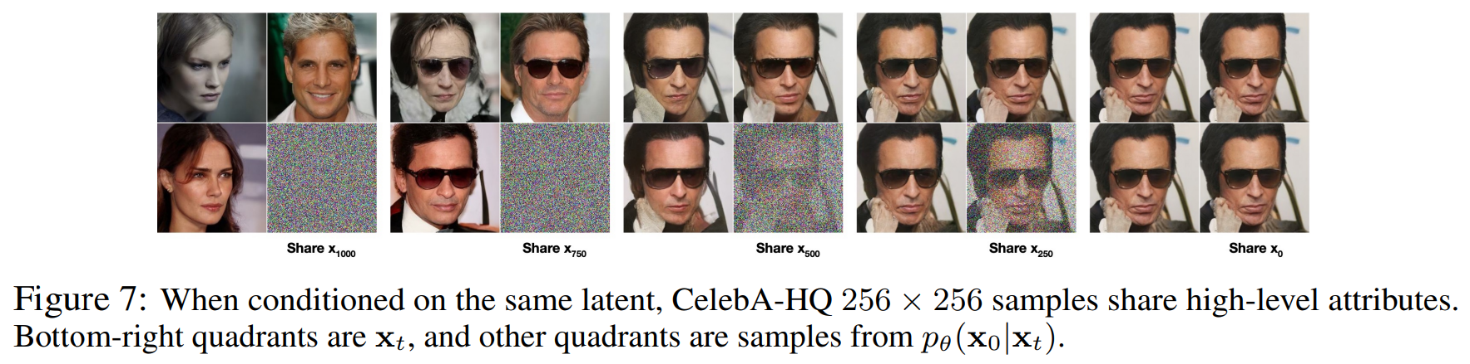
4. Experiments
4.3 Progressive coding

Slide 19

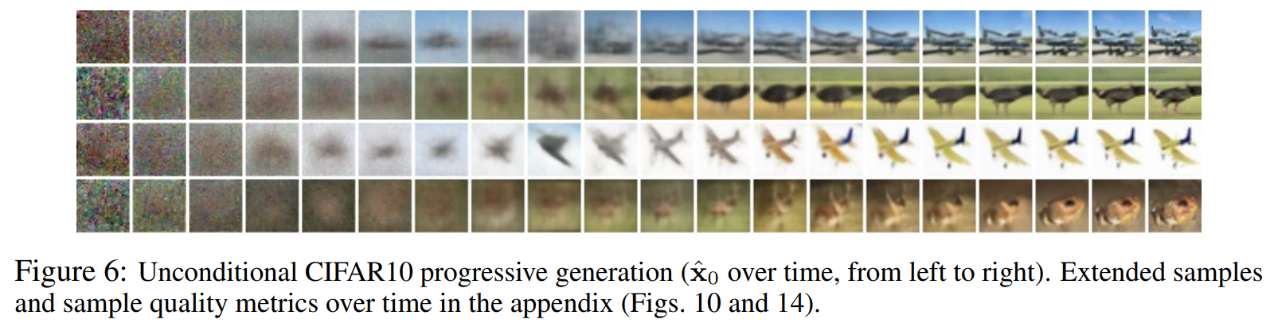
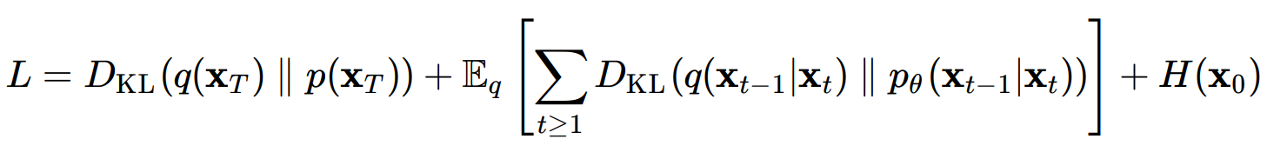
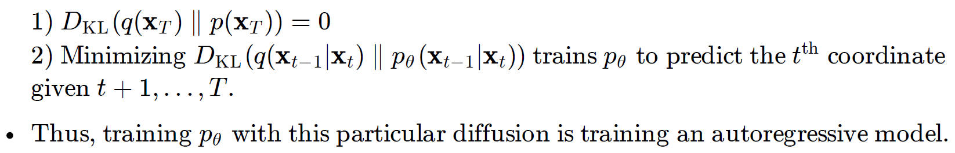
4. Experiments
4.3 Progressive coding

Slide 20
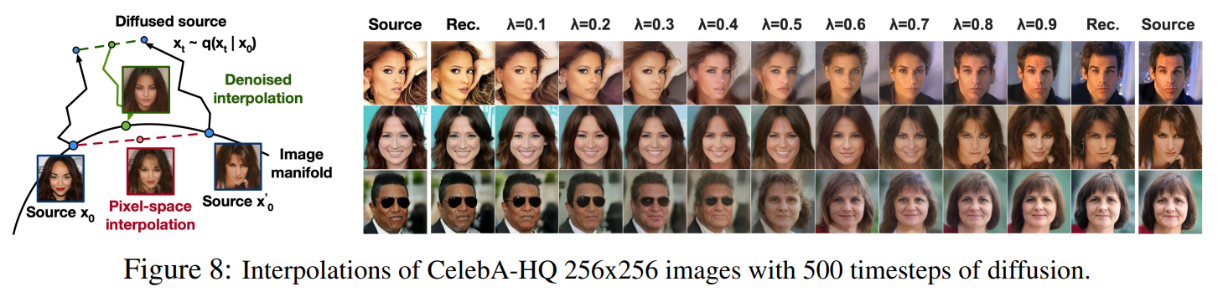
4. Experiments
4.4 Interpolation

Slide 21
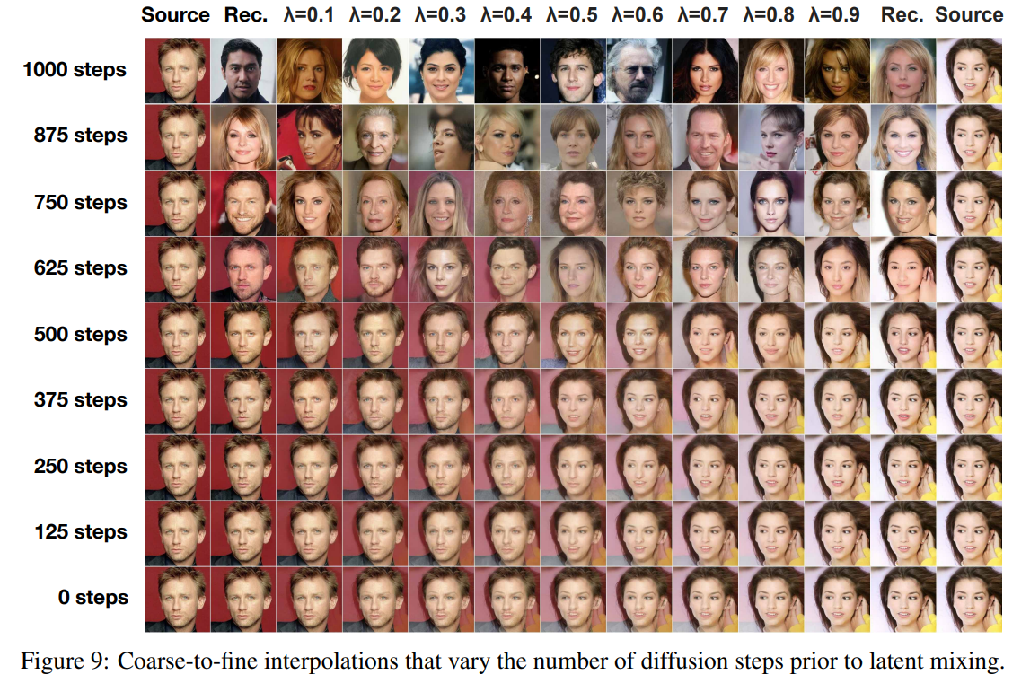
4. Experiments
4.4 Interpolation

Slide 22
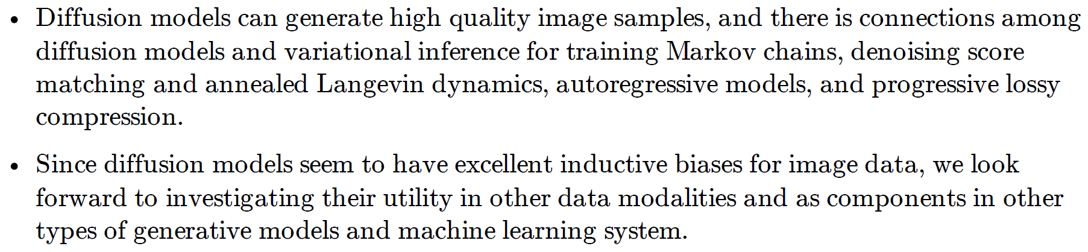
5. Conclusion

Slide 23

Collaborators
Radiology
Joon Beom Seo, SangMin Lee^{A,B}
Dong Hyun, Yang, Hyung Jin Won
Ho Sung Kim, Seung Chai Jung
Ji Eun Park, So Jung Lee
Jeong Hyun Lee, Gilsun Hong
Pathology
Hyunjeong Go, Gyuheon Choi
Gyungyub Gong, Dong Eun Song
Cardiology
Jaekwan Song, Jongmin Song
Young-Hak Kim
Anesthesiology
Sung-Hoon Kim, Eun Ho Lee
Neurology
Dong-Wha Kang, Chongsik Lee
Jaehong Lee, Sangbeom Jun
Misun Kwon, Beomjun Kim, Sun Kwon, Eun-Jae Lee
Surgery
Beom Seok Ko, JongHun Jeong
Songchuk Kim, Tae-Yon Sung
Gastroenterology
Jeongsik Byeon, Kang Mo Kim, Do-hoon Kim
Emergency Medicine
Dong-Woo Seo
Pulmonology and Critical Care Medicine
Yoen-mok Oh, Sei Won Lee, Jin-won Huh

